Slide 1
Grade 7
The Power of Point of View
Vocabulary
ELA Grade 7 The Power of Point of View, Lesson 2 Resource 2.1

Slide 2
Vocabulary
  point of view
  bias
  subjective
  objective

Slide 3

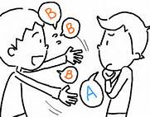
Point of view
A way that someone looks at or thinks about something.
When you work with other people, it is a good idea to try to see things from your teammates’ point of view.

Slide 4
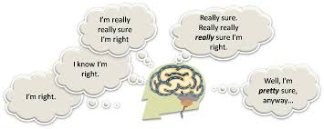
Bias
A leaning in favor of or against a person or issue
A good teacher will grade students fairly, with no bias.
Notes:
Similar to “prejudice”
At times bias has no basis in fact or reality
People aren’t always aware of their own bias – it will feel like “truth”

Slide 5
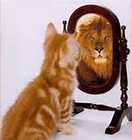
Subjective
Allowing personal beliefs, opinions, and attitudes to influence writing or interpretation
Notes:
Explain that the kitten is allowing its personal beliefs influence how it sees itself. In this case that’s a positive thing but often beliefs/ opinions/ attitudes can be negative and can show a situation or idea in a negative light.

Slide 6

Objective
Real, factual, without bias
“Lady Justice” is blind and weighs evidence without using her personal opinions.

Slide 7
A closer look at…
Objective vs. Subjective
Objective
gives information without judgment or evaluation
usually relies heavily on facts
tells actual events that occurred, without stating more than can be inferred
Subjective
includes personal view or opinion
may just describe something from the author’s point of view
may include facts but will probably exclude some facts that do not support opinion

